Slide 1

Immersive Technology Development
Lesson 3:
Custom and Multiple Image Targets
Elyas Chua-Aziz
cel9@np.edu.sg
Diploma in IM
October 2021

Slide 2
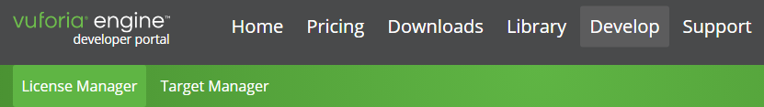
Custom Image Targets
Now that we have a simple AR application using sample assets, we will want to use personalized Image Targets.
To do so, we will create Custom Image Targets using the Vuforia Developer Portal.
Click on the Target Manager tab from the portal.
We will then add our own Database of Image Targets.

Slide 3
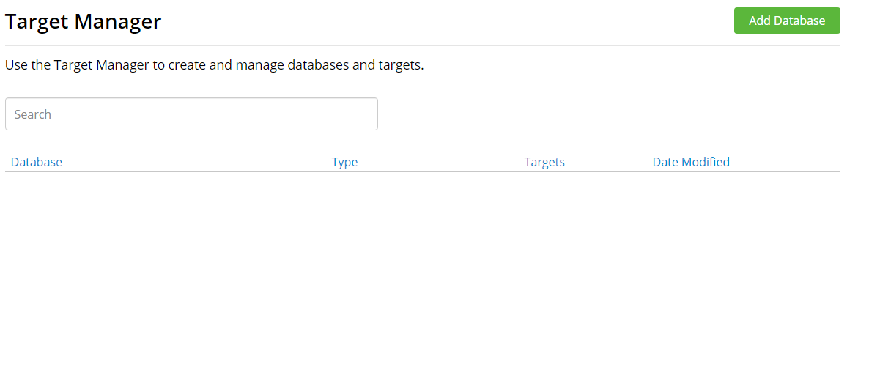
Custom Image Targets
Click on Add Database
Databases you create will appear here

Slide 4
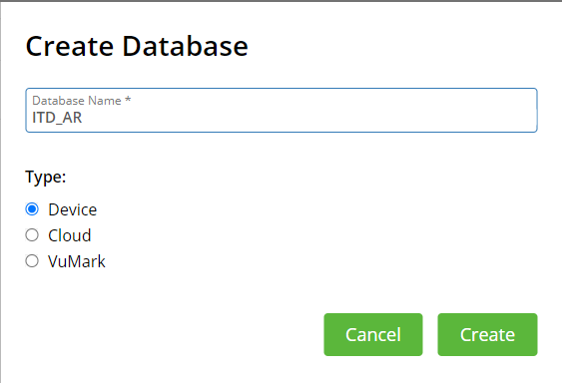
Custom Image Targets
Give your Database a name so that you can easily identify it.
Select Device as the Type.
Click on the Create button to create your new database.

Slide 5
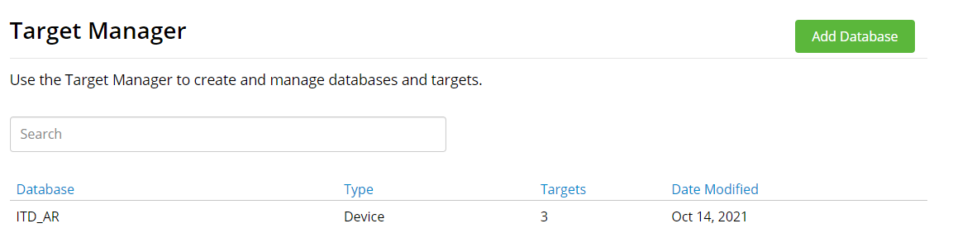
Custom Image Targets
Your new Database will appear in this space.
Notice that there are 0 Targets.
Click on the entry to create a new Image Target.

Slide 6
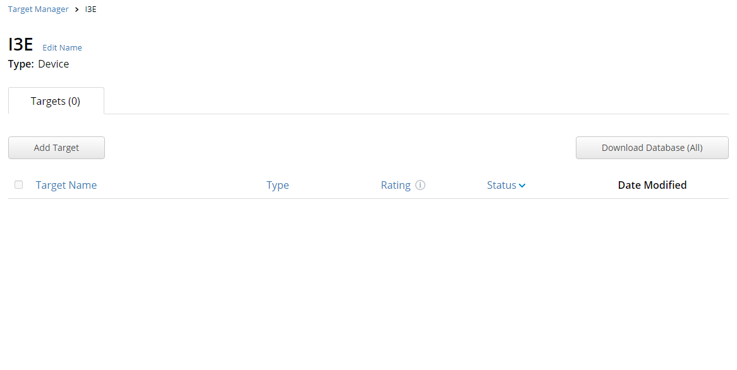

Custom Image Targets
Click on Add Target
Image Targets you create will appear here

Slide 7
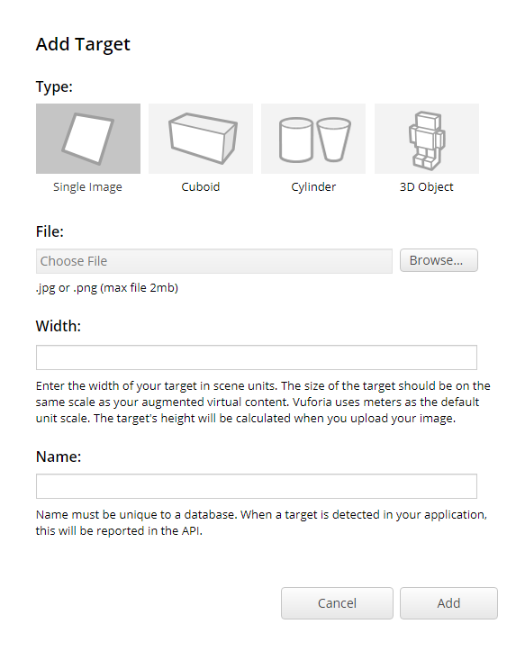
Custom Image Targets
Select the Single Image type.
Upload the image file you want to use.
Set the width of your Image Target. This value should be the same as your physical target that will be tracked.
Give your Image Target a name.
Click on the Add button.

Slide 8
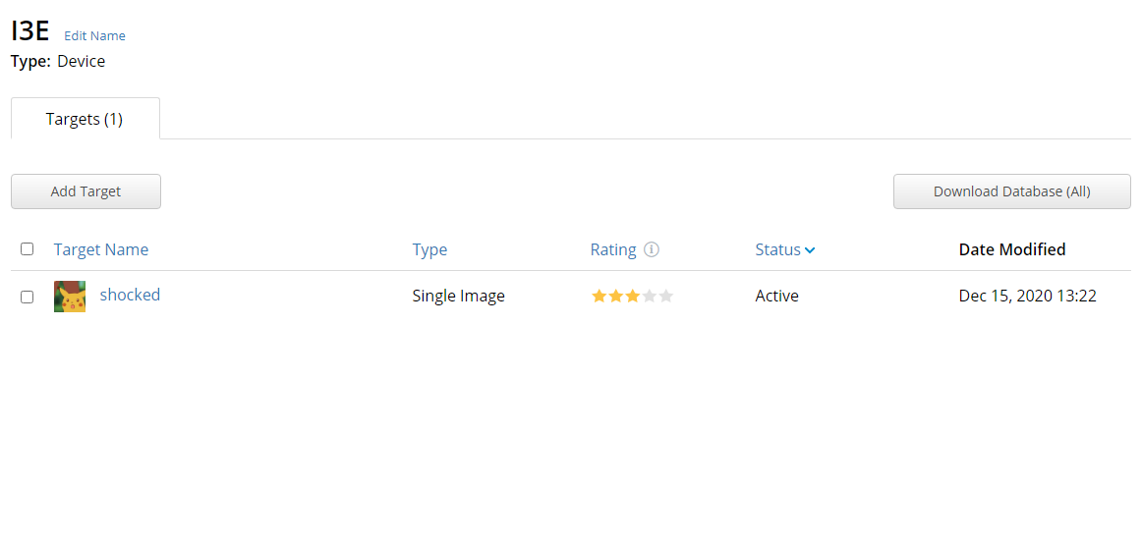
Custom Image Targets
Once you have all your Image Targets created, click on the Download Database button.
Choose to download it for Unity Editor
Vuforia will generate a Unity Package that we will import into our project.
Your new Image Target will appear here.
The Rating here lets you know how trackable your target will be.
A higher rating means it is more easily tracked.

Slide 9
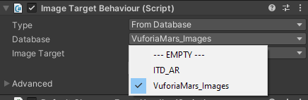
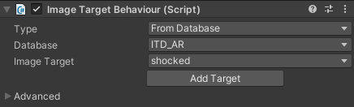
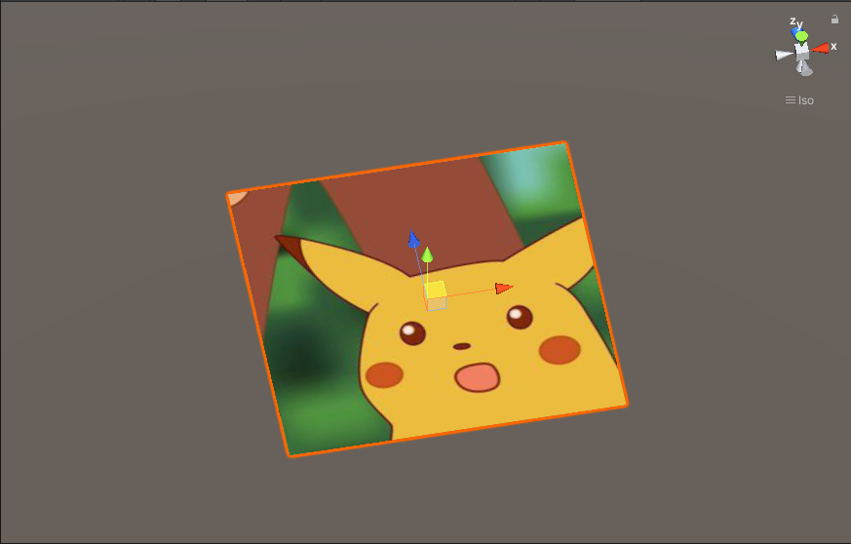
Custom Image Targets
Import the generated package in Unity.
You will now see the new database in the Database property in the Image Target component.
Select the new database and the Custom Image Targets will appear in the Image Target property.
You will now be able to track your own targets in your AR application.

Slide 10

Multiple Image Targets
With our Custom Image Targets now in our project, we may want to have our application track more than one Target at a time.
To do this, we must change some properties in the Vuforia Configuration File.
You can access this by going to your AR Camera and pressing the Open Vuforia Engine configuration button.
We have used this file to input our Vuforia License Key previously.

Slide 11
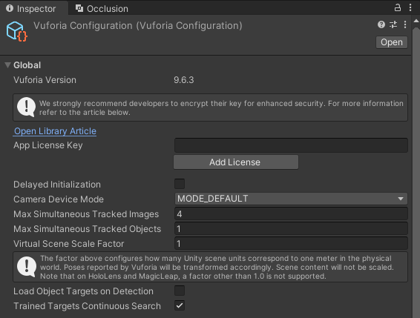
Multiple Image Targets
In the Vuforia Configuration file, change the value of Max Simultaneous Tracked Images to your desired value.
This will set the number of Image Targets your application can track at one time.

Slide 12
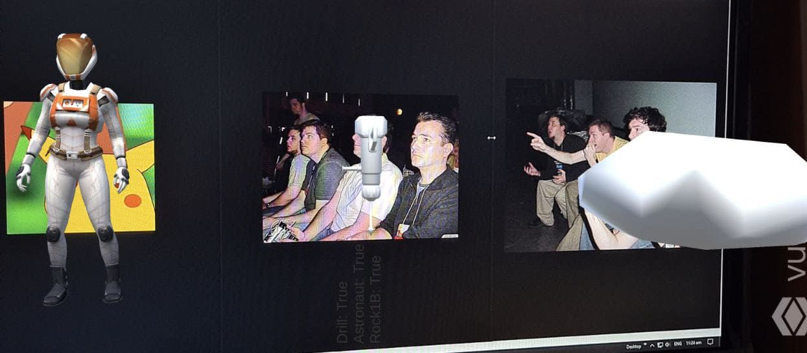
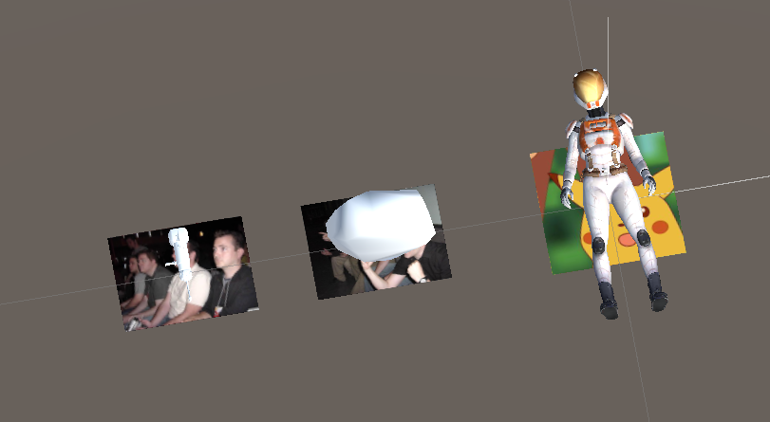
Multiple Image Targets
With that value set, we can now create multiple Image Targets in our scene.
Our application will overlay the respective 3D objects that are children of the corresponding Image Targets

Slide 13
Demo Time!

Slide 14
Your turn!
Create 3 custom Image Targets on Vuforia.
Download and import the database into your Unity project.
Test that all images can be detected and tracked, and take a screenshot.
Upload the photo here: https://docs.google.com/presentation/d/1CX9Yitl4qE97-v461sJGCCEg-TM74Zs1QKCRSwBYyKs/edit?usp=sharing

Slide 15
Scripting with Vuforia
Scanning and having objects be overlaid is the base of an AR app, but we will want to have additional functionalities built into our app through scripting.
To fully utilize Vuforia in our project, we first have to look into the Vuforia API.
API stands for Application Programming Interface.
An API is a tool that allows two different software to communicate with each other. In this case, the Vuforia API allows Unity and Vuforia to communicate.

Slide 16
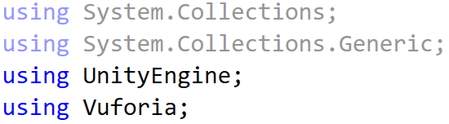
Scripting with Vuforia
The Vuforia API gives us access to classes and functions that we will use to affect how our AR application works.
You can look at the complete list of available classes and functions here: https://library.vuforia.com/content/vuforia-library/en/reference/unity/index.html
We first have to let our scripts know that we are using the Vuforia API by adding a using statement at the top of our script.

Slide 17
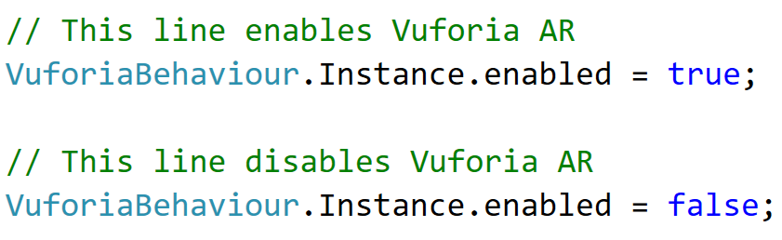
Toggling Vuforia AR
One of the basic features we want our application to have is toggling the AR camera feed on the fly.
The camera should only be turned on when the user wants to.
We will achieve this by using the VuforiaBehaviour class and its Instance.
This Instance variable from the VuforiaBehaviour class works just like our static instance variable in GameManager.
In this case, it gives us a reference to the AR behaviour of our application.

Slide 18
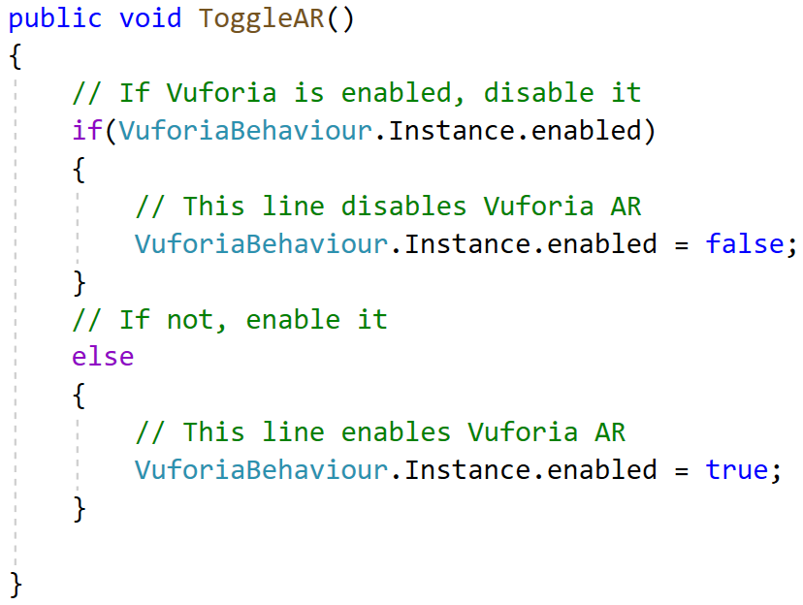
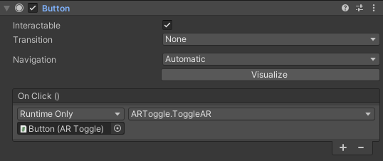
Toggling Vuforia AR
We can put those two lines into a function, then have that function be called when a UI Button is pressed.
Now, we can add this button on a Canvas that is using the Screen Space Overlay render mode and our users can toggle AR on the fly.

Slide 19
Demo Time!

Slide 20
Scripting with Vuforia
Another important feature our application could need is knowing whether objects are being tracked or not.
To do this, we can utilize a new type of data known as a Dictionary.

Slide 21


Dictionary
A Dictionary is a data type that stores key-value pairs.
These key-value pairs can be of any type of our choosing.
A Dictionary is created in this way:
We can then access the value of a pair by providing its key:
This example shows how to create a dictionary that holds int-string pairs.
We can then create a new int-string pair in this manner.
This line will result in ‘New Text’ being printed in the console.

Slide 22
Dictionary
Much like an English Dictionary, where the key is a word, and the value is its definition.
In this case of an English Dictionary, the data type of both the key and the value is string.
In scripting, we can store any data we want as our key or value.
To use it for tracking our objects, we will use GameObject as our key and bool as our value.
First, we will have to declare our Dictionary variable in a class.
Notice that we must also state what the data types for the key and value are here.

Slide 23
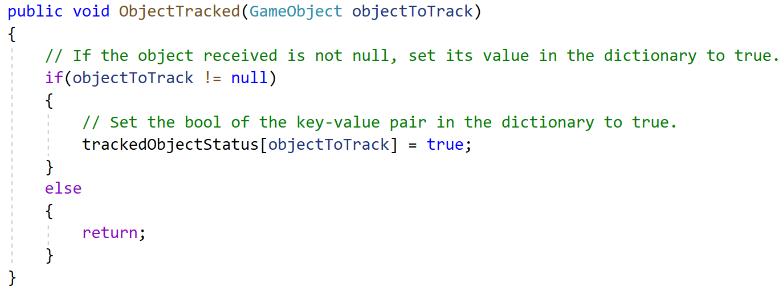
Using Dictionary with Vuforia
Next, we write a function in our class to keep track of our objects using the Dictionary.
Note how we can access the value of the key-value pair by using the GameObject as the “index”.

Slide 24
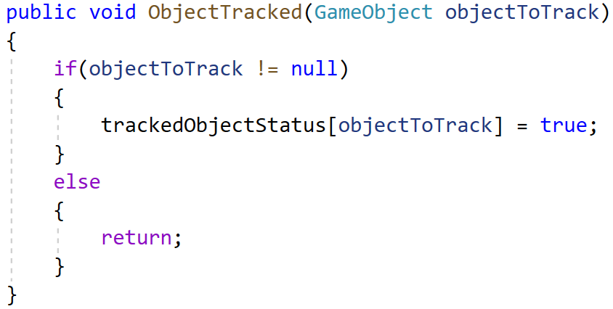
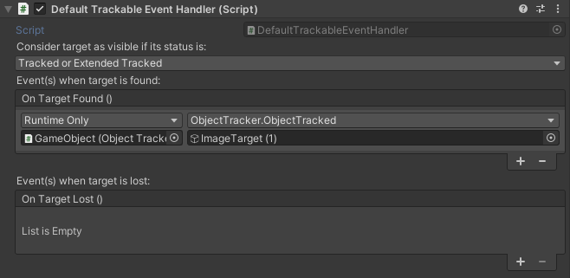
Using Dictionary with Vuforia
Now, we can go to our ImageTarget in Unity and look for the DefaultTrackableEventHandler component.
In the On Target Found() section, add the function to the list.
Our ImageTarget will now call the ObjectTracked function whenever it is found in AR.

Slide 25
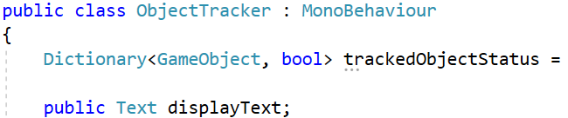
Using Dictionary with Vuforia
Now that we have our Dictionary set to be updated by our object when it gets tracked, we will want to display this information.
Instead of using the usual Debug.Log, we will use a Canvas and Text object to display any debugging text.
This is because we won’t be able to see the console when testing on the phone.
First, create a Canvas and a Text object in the Unity scene.
Next, create a public Text variable in your class and drag the Text object in the Inspector.

Slide 26
Demo Time!

Slide 27
Using Dictionary with Vuforia
Now that we have one object being tracked, let’s try and track every item in the Dictionary.
To do that, we will use a foreach loop.
Like a for loop, a foreach loop iterates through an array or collection.
The main difference is that we do not need to provide an index to start from and a test case to make the loop stop.
Instead, we will provide the foreach loop with the type of element that we want to access in the collection.

Slide 28
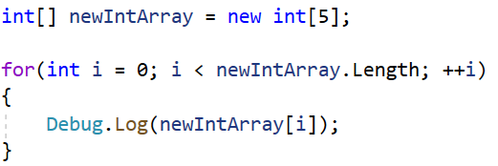
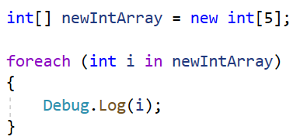
Using Dictionary with Vuforia
For loop:
Foreach loop:
element
collection
In the for loop, ‘i’ is used as an index and must be passed into the array to retrieve a value.
In the foreach loop, ‘i’ itself holds the value we want so we can use it directly without passing it as an index.
Comparing the two loops, we can see that the foreach loop is easier to write.
Although it comes at the cost of being a bit more ‘expensive’ to use.

Slide 29
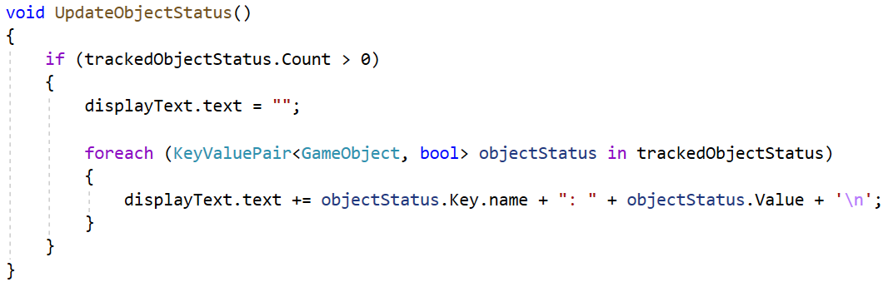
Using Dictionary with Vuforia
For our use case, the type of element we need to provide is a KeyValuePair that has GameObject as the key, and bool as the value:
We can then call UpdateObjectStatus() in the Update() function to have our Text object be updated constantly.
element
collection

Slide 30
Demo Time!

Slide 31
Summary
Using the Target Manager on Vuforia, we can create custom targets and databases for our AR applications.
We can use a combination of UI objects and Vuforia functionalities to toggle AR on/off, and tracking whether objects are in scene or not.
By extending this logic, we can implement a number of different features that our application might have.
E.g. simulated objects reacting with other simulated objects in the AR space, UI buttons that appear only when certain objects are overlaid on screen.

